Slide 1
Interactive Session on Hemodynamics
Dr. Raghavan Subramanyan

Slide 2
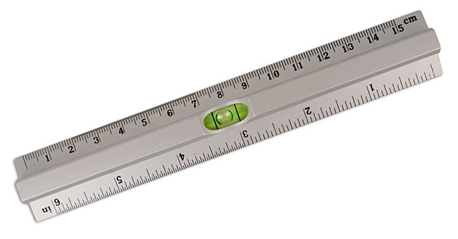
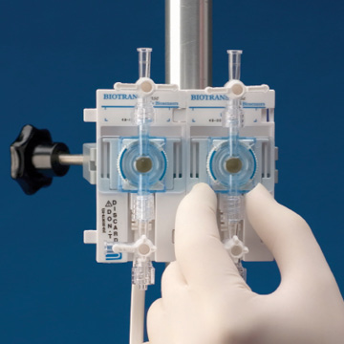
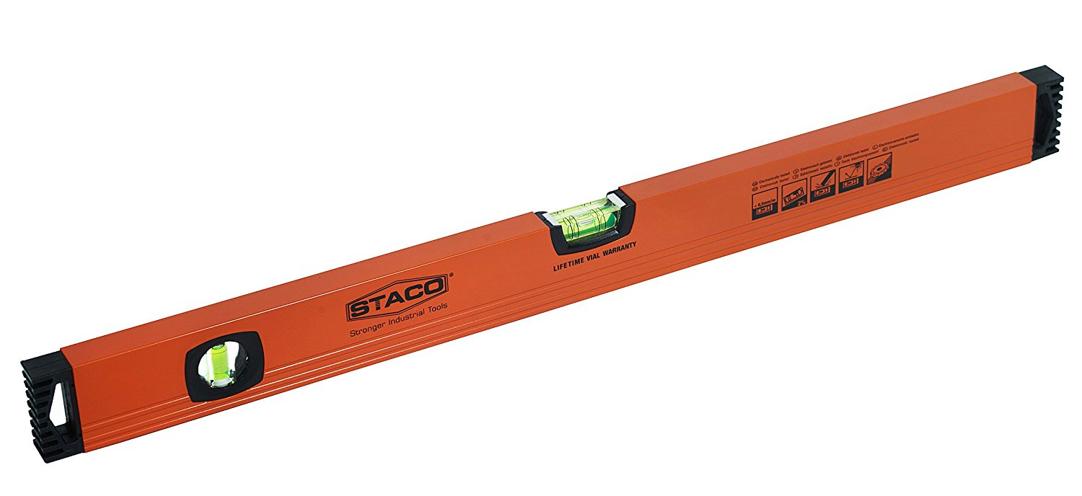

Slide 3
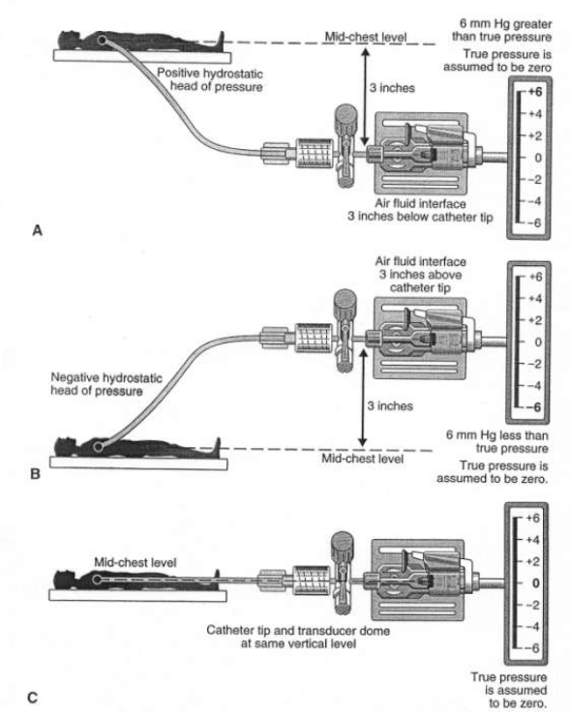
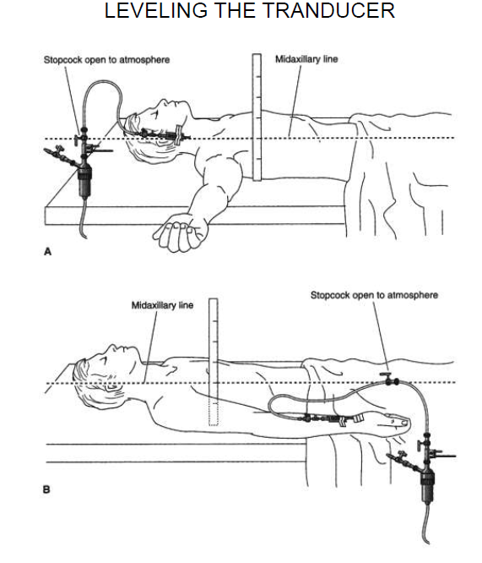

Slide 4
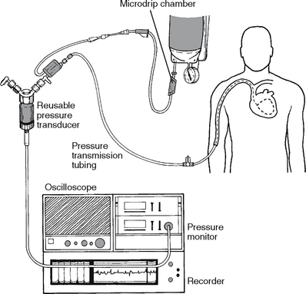
Quality of pressure record
Catheter/Connection Tube
Length
Diameter
Compliance
Lumen
Viscosity
Transducer
Pressure monitor system

Slide 5
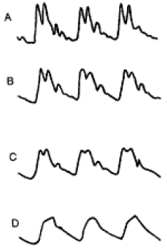
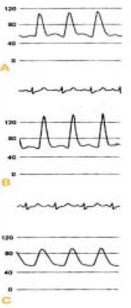
Artefacts in pressure tracing

Slide 6
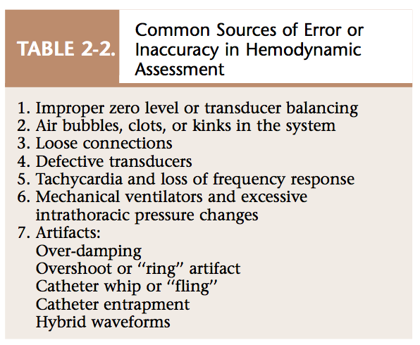
Sources of error

Slide 7
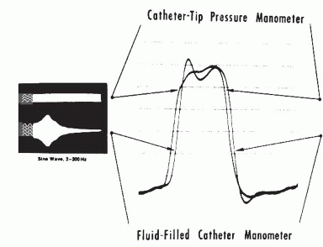

Slide 8
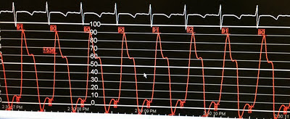
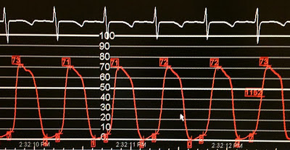
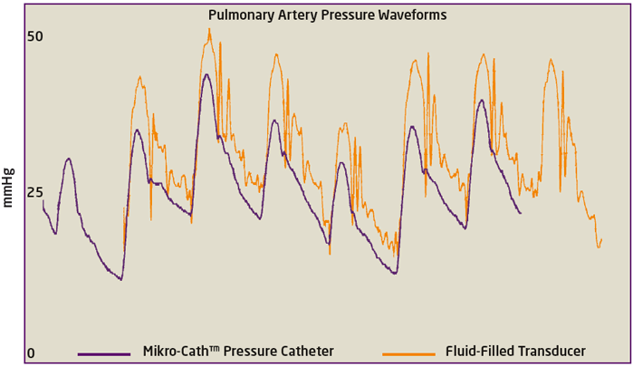

Slide 9
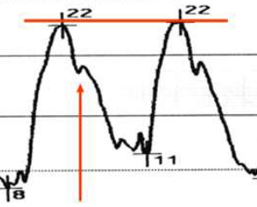
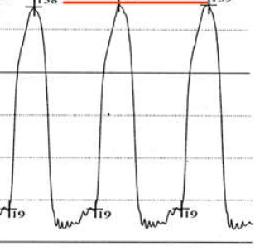
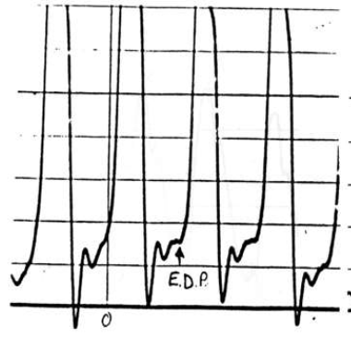
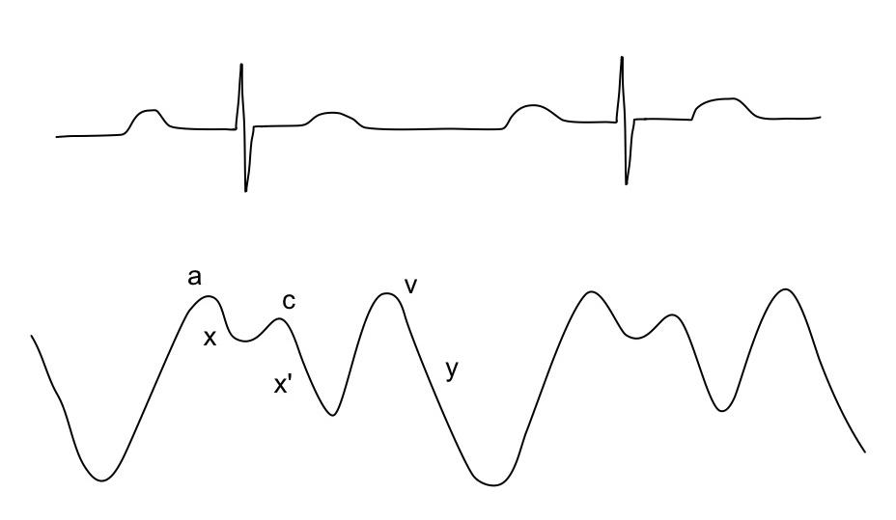

Slide 10
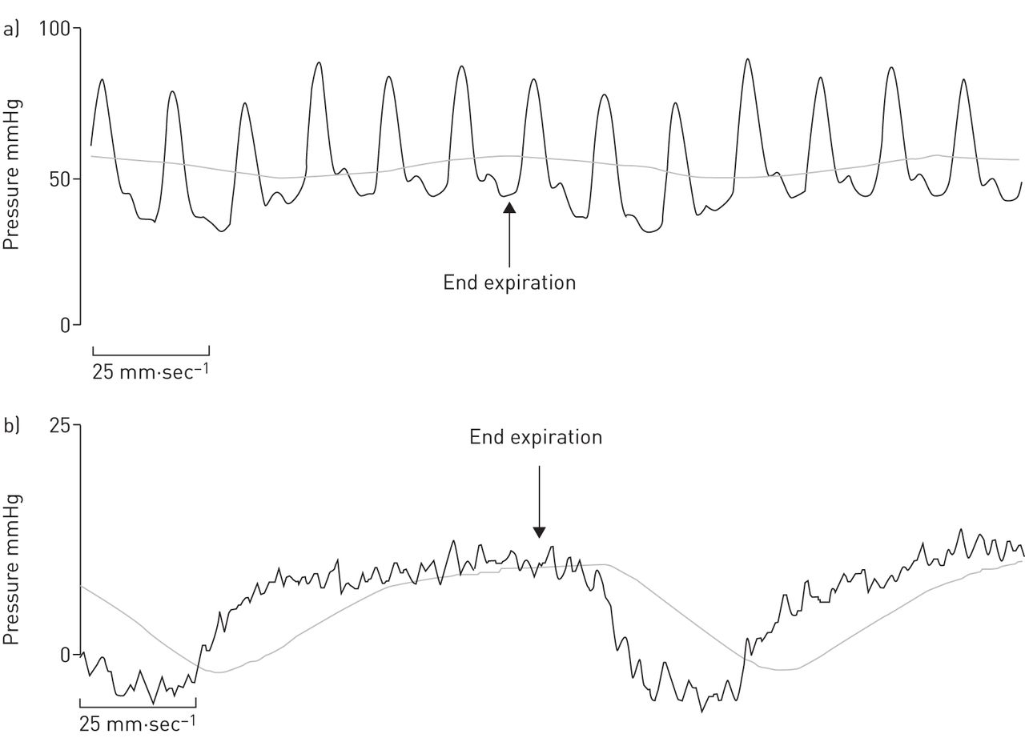
Respiratory variations

Slide 12
Constrictive Pericarditis
Insp
Exp
Congestive heart failure
Expiration

Slide 14
SVC 45%
RA 50% RA a9 v12 (12)
IVC 52%
RV 51% RV 78/8
PA 53% PA 78/36 (48)
PAW 95% PAW a24 v16 (26)
LV 92% LV 102/10
Ao 92% Ao 100/66 (70)
Notes:
Mitral stenosis

Slide 18
SVC 67%
RA 72% RA a7 v6 (6)
IVC 74% RV inflow 70/7
RV 70% RV apex 120/8
RVOT 72% RVOT 72/8
PA 71% PA 32/18 (24)
PAW 98% PAW a8 v12(12)
LV 99% LV 110/8
Ao 99% Ao 112/64 (72)
Notes:
Mild-moderate PS, catheter entrapment

Slide 19
SVC 67%
RA 72% RA a7 v6 (6)
IVC 74% RV inflow 70/7
RV 70% RV apex 120/8
RVOT 72% RVOT 72/8
PA 71% PA 32/18 (24)
PAW 98% PAW a8 v12(12)
LV 99% LV 110/8
Ao 99% Ao 112/64 (72)
Notes:
Mild-moderate PS, catheter entrapment

Slide 21
SVC 58%
RA 60% RA a8 v6 (7)
IVC 60%
RV 59% RV 50/8
PA 66% PA 48/36 (48)
PAW 97% PAW a14 v38 (25)
LV 92% LV 98/16
Ao 91% Ao 98/58 (70)
Notes:
Chronic Severe MR

Slide 28
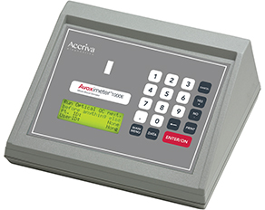
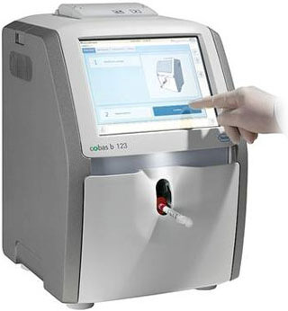
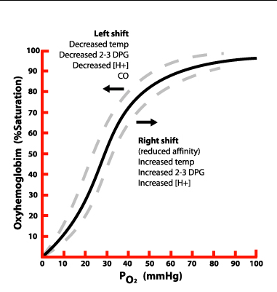
Measurement of Oxygen Content

Slide 31
Spirit level ruler

Slide 32
Catheter and Connecting Tube
Length
Diameter
Compliance
Lumen
Viscosity
Connecting Tube
Transducer
Pressure monitor system

Slide 34
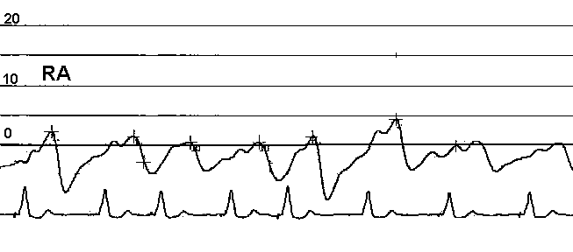
Interpret this pressure tracing and suggest corrective action
Notes:
RA pressure seems to be very low- in fact it appears to be below zero. Physiologically a sub-zero RA pressure is impossible. The first thing is to check and correct the level of the transducer to mid-chest level.
The wave form and respiratory variation are as expected – hence there is no problem with dampening or catheter block.
If after correcting the transducer level the RA pressure is still below 4 mmHG – suspect hypovolemia and effect of diuretics.

Slide 35
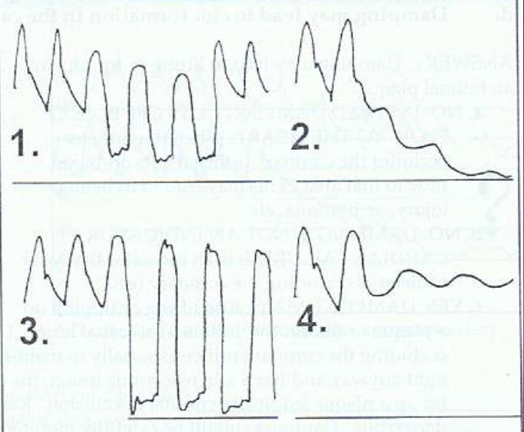
Interpret the four patterns of pressure record during coronary angiography and suggest corrective action
Notes:
Ventricularization of aortic pressure – possible LMCA stenosis or ostial stenosis. This can cause Myocardial ischaemia. Immediaely withdraw the catheter and do sinus injection.
Progressing dampening of aortic pressure with decline in wave form and pressure- Catheter tip against a wall or against a plaque or blockage of catheter due to debris or clot. Remedy is to withdraw the catheter and flush it.
Catheter has dropped into the LV and gives true LV pressure. Remedy is to withdraw the catheter to the aorta.
Dampening of the aortic pressure with wave form still present. The viscosity in the catheter is high – either due to blood or angiographic contrast medium. Solution is to flush with saline.

Slide 36
Comment on this PAWP tracing
End-insp
Notes:
Elevated PAW pressure of 22 mmHg
Patient on mechanical ventilation – the normal respiratory variation is reversed. Pressure is now higher in inspiration and lower in expiration.
However

Slide 37
Interpret this data set and suggest management
SVC 60%
RA 61% RA a10 v8 (9)
IVC 62%
RV 63% RV 54/10
PA 62% PA 52/28 (36)
PAW 95% PAW a30 v26 (30)
LV 94% LV 120/38
Ao 93% Ao 120/36 (50)
Notes:
Findings: Wide pulse pressure, LVEDP very high and equal to aortic diastolic pressure, High PAW pressure, Low PA saturation, mild hypoxia
Suggestive of Acute or recent onset severe AR.
Start afterload reducing agent – SNP or TNG, detect cause of AR and treat

Slide 38
Interpret this pressure tracing and give probable diagnosis
Notes:
Patient on IABP- showing diastolic augmentation of aortic pressure. Probably a case of cardiogenic shock or AMI with mechanical complication.

Slide 42
SVC 60%
RA 62% RA a9 v7 (8)
IVC 62%
RV 68% RV 102/8
PA 67% PA 40/14 (18)
PV 99%
LA 97% LA a10 v9 (8)
LV 97% LV 106/10
Ao 78% Ao 100/66 (68)
Notes:
TOF

Slide 43
SVC 68%
RA a10 v11 (10) 69%
IVC 76%
RV 86/9 79%
PA 84/48 (58) 78%
LA a9 V12 (10) 98%
LV 96/10 96%
Ao 98/70 (78) 88%
Notes:
PAH – R to L shunt – either VSD or PDA or APW

